Slide 1
Prepared By Priyanka C Application Engineer Ramaiah Skill Academy
SERIAL PERIPHERAL INTERFACE

Slide 2
Content
Introduction to SPI protocol
Basic SPI Architecture
Working Principle
SPI Modes(Clock Polarity and Clock Phase)
Timing Diagram
Advantages of SPI
Limitations of SPI
Multi-Slave configuration
Comparison with other protocols
Applications
References

Slide 3
Introduction to SPI
SPI is a Serial Bus communication Protocol developed by Motorola in late 1980s
It is a Synchronous, Full Duplex protocol and most used protocol for short distance communication
Used in microcontrollers, sensors, EEPROMS, ADCs, DACs etc
Has a simple hardware interface
Provides high-speed data transfer
Supports single or multiple slave devices but has only one master that controls all communications

Slide 4
Basic SPI Architecture
Master-Slave Configuration
One master controls the communication
One or more slaves respond to the master
There are Four main signals:
MOSI (Master Out Slave In) → used for sending data from Master to Slave
MISO (Master In Slave Out) → used for sending data from Slave to Master
SCLK (Serial Clock) → used to clock the signal
SS/CS (Slave Select / Chip Select) → used by master to send the data by selecting a particular slave. It is used when there are multiple slaves in the design

Slide 5
Basic SPI Architecture
SPI MASTER / CONTROLLER
SPI SLAVE / PERIPHERAL
MOSI
MOSI
MISO
MISO
SCLK
SCLK
SS/CS
SS/CS

Slide 6
Working Principle
Clock Synchronization: where Master generates the clock SCLK
All data transfers are synchronized to this clock.
Data Shifts occur on clock edges determined by SPI mode.
Data Transfer
Master sends data to the slave vis MOSI
Slave responds with data via MISO
Transfer happens in full duplex mode i.e., simultaneous read and write operations
Chip Selection
SS is driven low to select a slave
If a particular slave is not selected, it remains inactive and ignores SCLK and MOSI.
Data Frame
SPI uses a shift register based data frame
Data is typically transferred as 8 bits at a time but it can be extended

Slide 7
SPI Modes ( Clock Polarity and Phase)
Mode 0 :
CPOL = 0, CPHA = 0
Data is sampled on rising edge
Mode 1 :
CPOL = 0, CPHA = 1
Data is sampled on falling edge
Mode 2 :
CPOL = 1, CPHA = 0
Data is sampled on falling edge
Mode 3 :
CPOL = 1, CPHA = 1
Data is sampled on rising edge
How to choose a mode for given hardware?

Slide 8
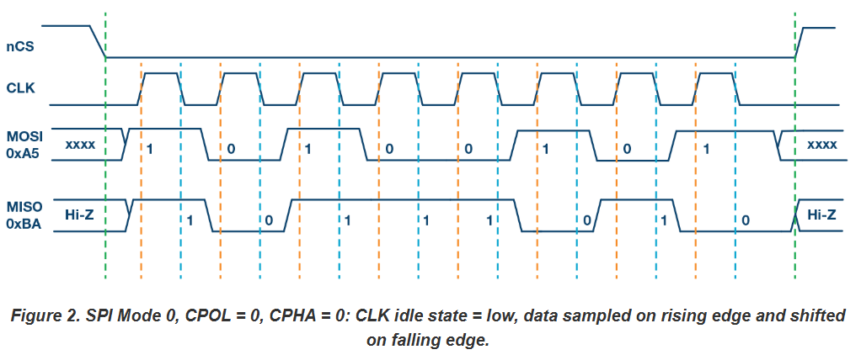
Timing Diagram
Start
End
Sampling edge
Shifting edge
Reference: www.analog.com

Slide 9
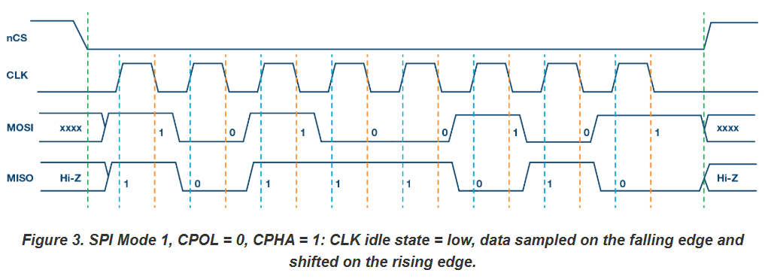
Timing Diagram
Reference: www.analog.com

Slide 10
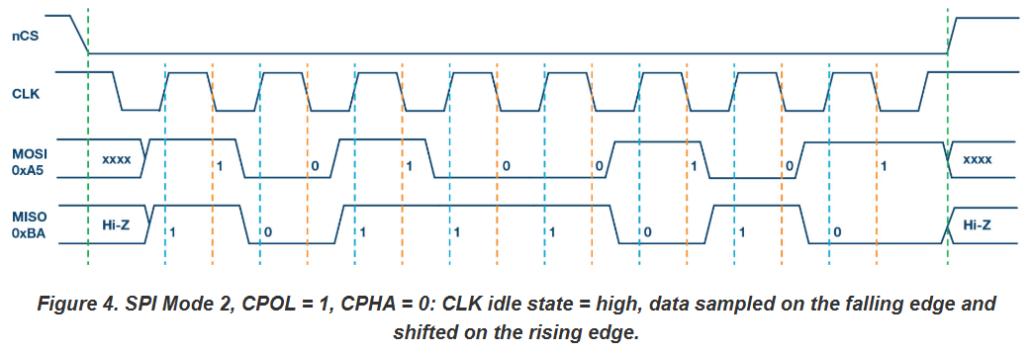
Timing Diagram
Reference: www.analog.com

Slide 11
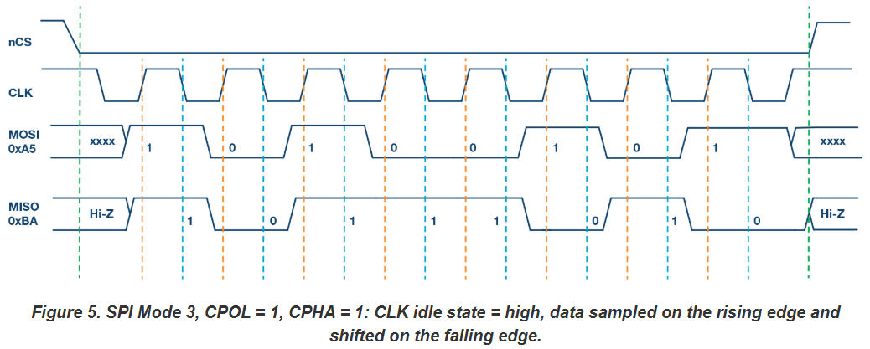
Timing Diagram
Reference: www.analog.com

Slide 12
Advantages of SPI
High speed data transfer
Simple Implementation
Full-duplex communication
Low power consumption
Easy to daisy-chain multiple devices

Slide 13
Limitations of SPI
No formal standard
Limited to short distances
Requires more pins than I2C
Only one master at a time
Handling multiple slaves requires extra control logic

Slide 14
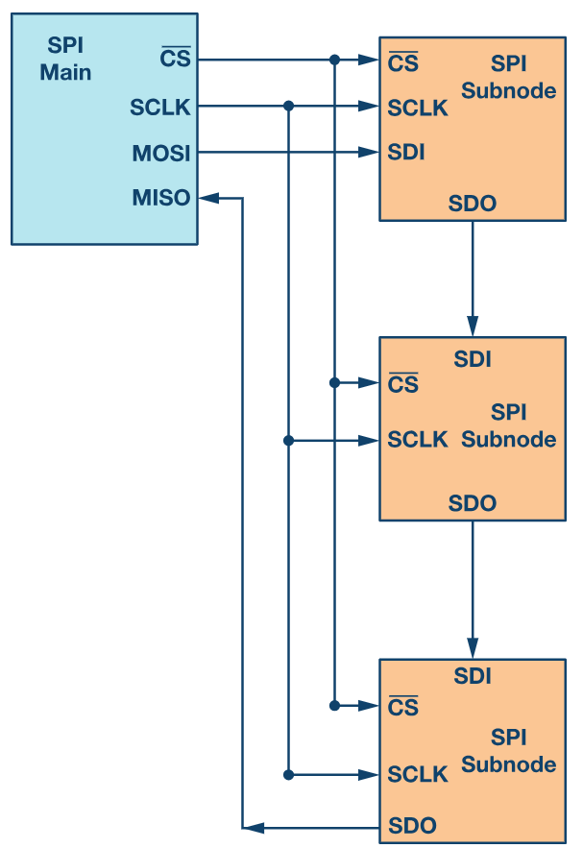
Multi-Slave Configuration
Daisy-Chain:
Single data line for all slaves
Advantages:
Reduces number of SS lines
Simple hardware connections
Disadvantages:
Slower due to cascading delays
Single point of failure
Reference: www.analog.com

Slide 15
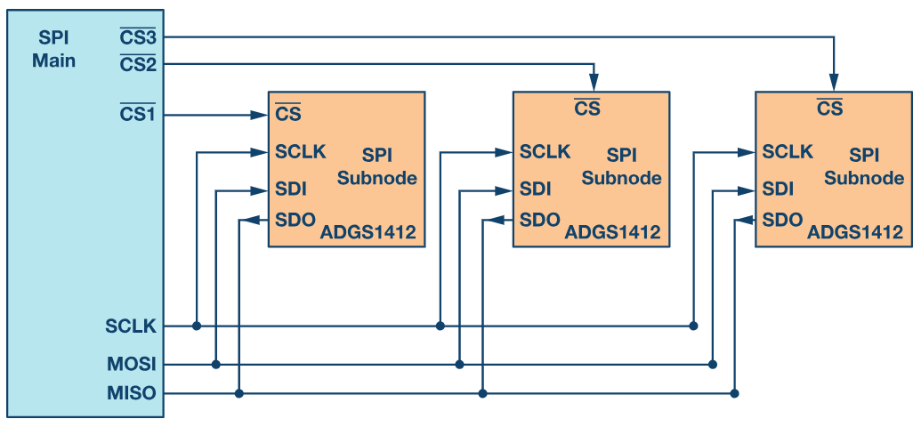
Multi-Slave Configuration
Individual SS Lines:
Each slave has a dedicated SS line
Advantages:
Faster Communication
Better Fault Isolation
Disadvantages:
Requires more GPIO pins
Complex hardware wiring for
large systems
Reference: www.analog.com

Slide 16
Comparison with other Protocols
Feature | SPI | I2C | UART | CAN
Speed | High | Moderate | Moderate | Low
Number of Wires | 4 (min) | 2 | 2 | 2
Full Duplex | Yes | No | No | No
Master-Slave | Single Master, Multi-Slave | Multi-Master, Multi-Slave | Point-to-Point | Multi-Master, Multi-Slave
Addressing | No | Yes | No | Yes
Robustness | Low | Medium | Medium | High
Range | Short | Short-Medium | Medium | Long

Slide 17
Applications
Consumer Electronics:
SD Cards, Touch screens
Industrial:
Sensors, Actuators
Automotive:
ECU communication

Slide 18
Assignment
Design an SPI module in Verilog that includes both spi_master and spi_slave functionalities.
Implement 8-bit data transfer with support for all four SPI modes (CPOL, CPHA).
Ensure the master generates the clock (SCLK) and the slave communicates based on the Slave Select (SS) signal.
Write a testbench to verify full-duplex communication for a given sequence of data bytes and validate correct operation through simulation waveforms.
Explain how your design would handle scenarios where the clock speed of the SPI master is higher than the capability of the slave.

Slide 19
References
"Serial Communication Protocols: Principles and Applications" by Robert J. Anderson, Wiley, 2020.
2. "Microcontroller Systems: Advanced Design Techniques" by John H. Davies, Elsevier, 2019.

